Slide 1
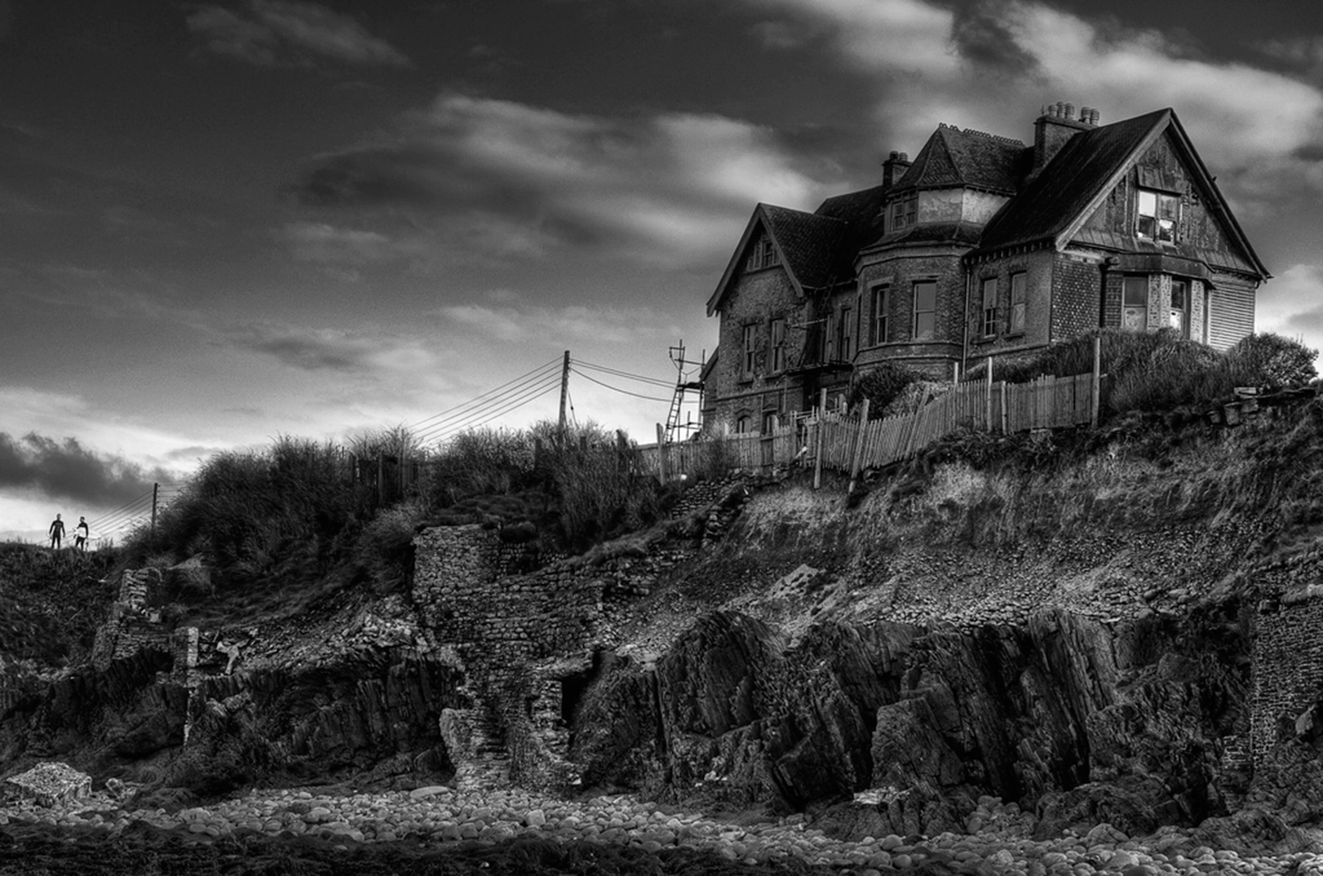
Write in varied sentences.
Use the full range of punctuation (complex lists work brilliantly).
Vary your paragraphs.
Describe, describe, describe!
You need incredible vocab. There are suggestions below.
trickle, dribble/flow, plunge/cascade, swell, splash, flood, calm/peaceful/placid/serene/still, rough/tempestuous/turbulent, fetid/stagnant/stale, wander/meander, roar, glassy/mirrored, crystal
WATER
Spark/ignite/combust, blaze, wildfire, inferno, stinging, suffocating/choking,, fumes, cinders/embers, scorching/blistering/searing, hellish/devil, raging, incandescent, coruscating, phosphorescent
FIRE
hail, sleet, icicles, snowflakes, flurries/snowdrifts, slush, blizzard, bleak/wintry/harsh, settle, shiver, numb, thaw/melt, biting/bitter, cutting/pitiless/merciless, refrigerated, blanket of snow, arctic, crystal, glacial, hoarfrost
Write a description as suggested by this image.
OR
Write a story set in an isolated location.
[AO5 24 marks, AO6 16 marks]
ICE
You need a strong structure. There are suggestions below.

Slide 2
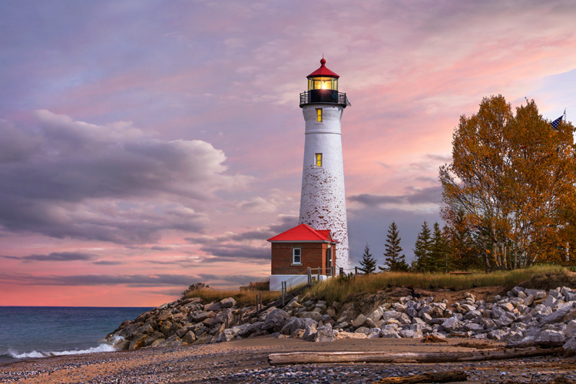
Write in varied sentences.
Use the full range of punctuation (complex lists work brilliantly).
Vary your paragraphs.
Describe, describe, describe!
You need incredible vocab. There are suggestions below.
trickle, dribble/flow, plunge/cascade, swell, splash, flood, calm/peaceful/placid/serene/still, rough/tempestuous/turbulent, fetid/stagnant/stale, wander/meander, roar, glassy/mirrored, crystal
WATER
Spark/ignite/combust, blaze, wildfire, inferno, stinging, suffocating/choking,, fumes, cinders/embers, scorching/blistering/searing, hellish/devil, raging, incandescent, coruscating, phosphorescent
FIRE
hail, sleet, icicles, snowflakes, flurries/snowdrifts, slush, blizzard, bleak/wintry/harsh, settle, shiver, numb, thaw/melt, biting/bitter, cutting/pitiless/merciless, refrigerated, blanket of snow, arctic, crystal, glacial, hoarfrost
Write a description as suggested by this image.
OR
Write a story set at sea.
[AO5 24 marks, AO6 16 marks]
ICE
You need a strong structure. There are suggestions below.

Slide 3
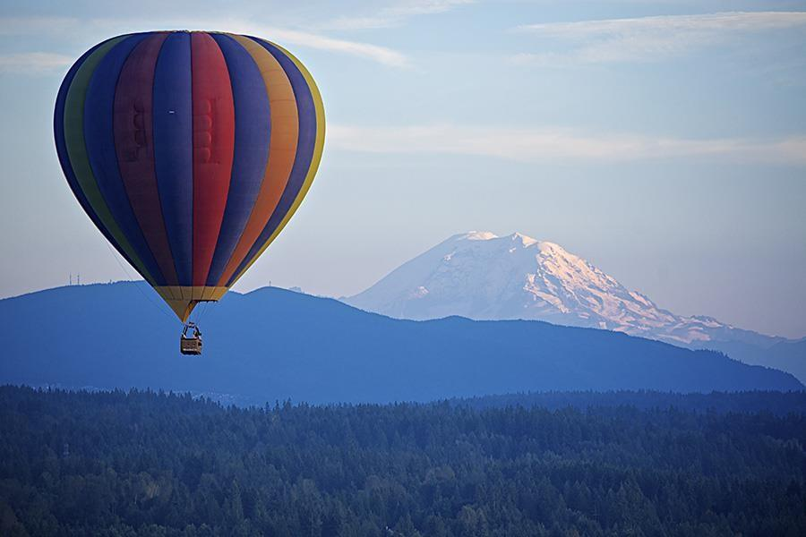
Write in varied sentences.
Use the full range of punctuation (complex lists work brilliantly).
Vary your paragraphs.
Describe, describe, describe!
You need incredible vocab. There are suggestions below.
trickle, dribble/flow, plunge/cascade, swell, splash, flood, calm/peaceful/placid/serene/still, rough/tempestuous/turbulent, fetid/stagnant/stale, wander/meander, roar, glassy/mirrored, crystal
WATER
Spark/ignite/combust, blaze, wildfire, inferno, stinging, suffocating/choking,, fumes, cinders/embers, scorching/blistering/searing, hellish/devil, raging, incandescent, coruscating, phosphorescent
FIRE
hail, sleet, icicles, snowflakes, flurries/snowdrifts, slush, blizzard, bleak/wintry/harsh, settle, shiver, numb, thaw/melt, biting/bitter, cutting/pitiless/merciless, refrigerated, blanket of snow, arctic, crystal, glacial, hoarfrost
Write a description as suggested by this image.
OR
Write a story about an adventure.
[AO5 24 marks, AO6 16 marks]
ICE
You need a strong structure. There are suggestions below.

Slide 4
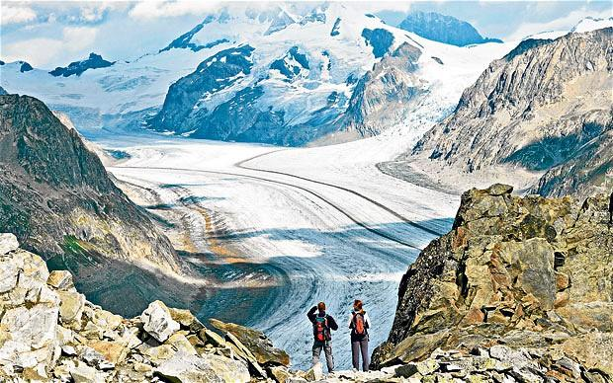
Write in varied sentences.
Use the full range of punctuation (complex lists work brilliantly).
Vary your paragraphs.
Describe, describe, describe!
You need incredible vocab. There are suggestions below.
trickle, dribble/flow, plunge/cascade, swell, splash, flood, calm/peaceful/placid/serene/still, rough/tempestuous/turbulent, fetid/stagnant/stale, wander/meander, roar, glassy/mirrored, crystal
WATER
Spark/ignite/combust, blaze, wildfire, inferno, stinging, suffocating/choking,, fumes, cinders/embers, scorching/blistering/searing, hellish/devil, raging, incandescent, coruscating, phosphorescent
FIRE
hail, sleet, icicles, snowflakes, flurries/snowdrifts, slush, blizzard, bleak/wintry/harsh, settle, shiver, numb, thaw/melt, biting/bitter, cutting/pitiless/merciless, refrigerated, blanket of snow, arctic, crystal, glacial, hoarfrost
Write a description as suggested by this image.
OR
Write a story about a memorable journey.
[AO5 24 marks, AO6 16 marks]
ICE
You need a strong structure. There are suggestions below.

Slide 5
Write in varied sentences.
Use the full range of punctuation (complex lists work brilliantly).
Vary your paragraphs.
Describe, describe, describe!
You need incredible vocab. There are suggestions below.
trickle, dribble/flow, plunge/cascade, swell, splash, flood, calm/peaceful/placid/serene/still, rough/tempestuous/turbulent, fetid/stagnant/stale, wander/meander, roar, glassy/mirrored, crystal
WATER
Spark/ignite/combust, blaze, wildfire, inferno, stinging, suffocating/choking,, fumes, cinders/embers, scorching/blistering/searing, hellish/devil, raging, incandescent, coruscating, phosphorescent
FIRE
hail, sleet, icicles, snowflakes, flurries/snowdrifts, slush, blizzard, bleak/wintry/harsh, settle, shiver, numb, thaw/melt, biting/bitter, cutting/pitiless/merciless, refrigerated, blanket of snow, arctic, crystal, glacial, hoarfrost
Write a description as suggested by this image.
OR
Write a story about an accident.
[AO5 24 marks, AO6 16 marks]
ICE
You need a strong structure. There are suggestions below.

Slide 6
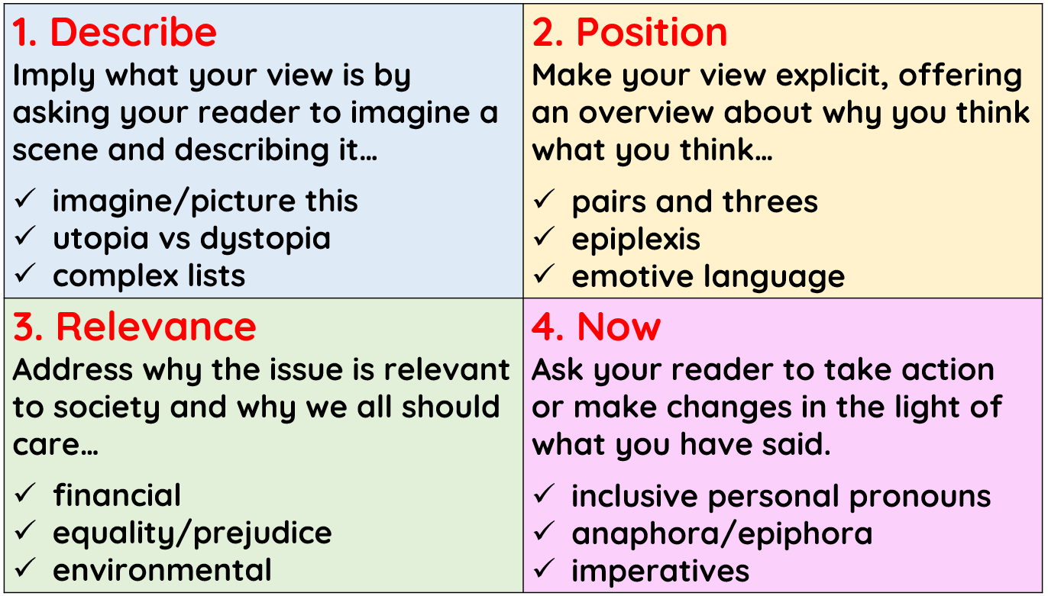
Triplet/Colon/Sentence – can be used as a headline
Rude, selfish, ignorant: today’s school pupils are the most disgraceful young people we have ever seen.
Imagine the scene… Picture a world… etc
Utopia vs Dystopia
The world as it is vs how it could be
Something amazing vs something terrible – you are trying to create juxtaposition
Complex Lists
Make a statement.
Use a colon.
Write the items in your list.
Separate the items with semi colons.
You can use commas and brackets in your items.
Vocab Upgrades
absolutely absurd – totally stupid
woefully inadequate – not good enough
inevitable consequences – things can’t be stopped
myriad reasons – lots of reasons
a moral imperative – something we must do
Here are lots of techniques you may have covered with your teacher.
Each technique is linked to part of a four-paragraph structure you might want to use.
Pairs and Threes – things work well in groups
It’s the answer spoken by young and old, rich and poor, Democrat and Republican, by black, white or Latino, by gay, straight, bisexual, disabled and able-bodied people.
Epiplexis
A whole bunch of rhetorical questions one after another.
Emotive Language
Language designed to make people feel something: hungry is good, starving is better; poor is good, destitute is better.
Relevance: why should people care about this issue?
Financial – how will affect how much money they have now or in the future?
Equality/Prejudice – does this affect everyone equally? Does it make existing problems worse?
Environment – is it good or bad for the planet?
Almost everything can be linked to these three ideas.
Inclusive Personal Pronouns
We, us, our, friends, etc…
Anaphora
Repeated phrases at the start: I have a dream!
Epiphora
Repeated phrases at the end.
Imperatives
Tell people what to do: protest against the government, refuse to back down, shout it from the rooftops, etc…
Mobile phones are a computer in your pocket and it would make sense to allow students to use them in lessons. Write a letter to your head teacher persuading them to allow it.
[AO5 24 marks, AO6 16 marks]

Slide 7
Triplet/Colon/Sentence – can be used as a headline
Rude, selfish, ignorant: today’s school pupils are the most disgraceful young people we have ever seen.
Imagine the scene… Picture a world… etc
Utopia vs Dystopia
The world as it is vs how it could be
Something amazing vs something terrible – you are trying to create juxtaposition
Complex Lists
Make a statement.
Use a colon.
Write the items in your list.
Separate the items with semi colons.
You can use commas and brackets in your items.
Vocab Upgrades
absolutely absurd – totally stupid
woefully inadequate – not good enough
inevitable consequences – things can’t be stopped
myriad reasons – lots of reasons
a moral imperative – something we must do
Here are lots of techniques you may have covered with your teacher.
Each technique is linked to part of a four-paragraph structure you might want to use.
Pairs and Threes – things work well in groups
It’s the answer spoken by young and old, rich and poor, Democrat and Republican, by black, white or Latino, by gay, straight, bisexual, disabled and able-bodied people.
Epiplexis
A whole bunch of rhetorical questions one after another.
Emotive Language
Language designed to make people feel something: hungry is good, starving is better; poor is good, destitute is better.
Relevance: why should people care about this issue?
Financial – how will affect how much money they have now or in the future?
Equality/Prejudice – does this affect everyone equally? Does it make existing problems worse?
Environment – is it good or bad for the planet?
Almost everything can be linked to these three ideas.
Inclusive Personal Pronouns
We, us, our, friends, etc…
Anaphora
Repeated phrases at the start: I have a dream!
Epiphora
Repeated phrases at the end.
Imperatives
Tell people what to do: protest against the government, refuse to back down, shout it from the rooftops, etc…
Obsession with becoming a reality TV star or an influencer has made young people forget the value of hard work. Write a speech for your next assembly convincing your year group to aim for academic success, not fame! [AO5 24 marks, AO6 16 marks]

Slide 8
Triplet/Colon/Sentence – can be used as a headline
Rude, selfish, ignorant: today’s school pupils are the most disgraceful young people we have ever seen.
Imagine the scene… Picture a world… etc
Utopia vs Dystopia
The world as it is vs how it could be
Something amazing vs something terrible – you are trying to create juxtaposition
Complex Lists
Make a statement.
Use a colon.
Write the items in your list.
Separate the items with semi colons.
You can use commas and brackets in your items.
Vocab Upgrades
absolutely absurd – totally stupid
woefully inadequate – not good enough
inevitable consequences – things can’t be stopped
myriad reasons – lots of reasons
a moral imperative – something we must do
Here are lots of techniques you may have covered with your teacher.
Each technique is linked to part of a four-paragraph structure you might want to use.
Pairs and Threes – things work well in groups
It’s the answer spoken by young and old, rich and poor, Democrat and Republican, by black, white or Latino, by gay, straight, bisexual, disabled and able-bodied people.
Epiplexis
A whole bunch of rhetorical questions one after another.
Emotive Language
Language designed to make people feel something: hungry is good, starving is better; poor is good, destitute is better.
Relevance: why should people care about this issue?
Financial – how will affect how much money they have now or in the future?
Equality/Prejudice – does this affect everyone equally? Does it make existing problems worse?
Environment – is it good or bad for the planet?
Almost everything can be linked to these three ideas.
Inclusive Personal Pronouns
We, us, our, friends, etc…
Anaphora
Repeated phrases at the start: I have a dream!
Epiphora
Repeated phrases at the end.
Imperatives
Tell people what to do: protest against the government, refuse to back down, shout it from the rooftops, etc…
Young people are blamed for everything, but it’s adults who are messing the world up! Write a magazine article arguing your point of view on this issue!
[AO5 24 marks, AO6 16 marks]

